Slide 1




Final-Year Project Presentation Computer Engineering Department
SIR SYED UNIVERSITY OF ENGINEERING & TECHNOLOGY

Slide 2
Group Members
Zahir Khan (GL) (2020-CE-121)
Adil Aijaz (2020-CE-095)
Qasim (2020-CE-113)
Ramish Masood (2020-CE-086)

Slide 3
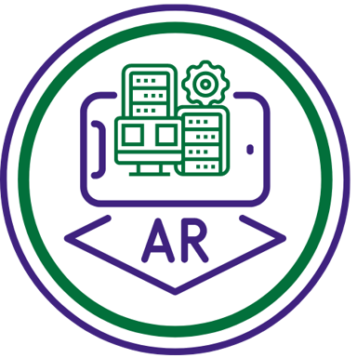
Augmented Reality Based Computer Fundamentals Course
Our project aims to utilize AR technology to make visualizing computer components and devices more engaging and interactive for students. Traditional teaching methods like lectures and diagrams can be dry and challenging for students, but with our AR application, students can enjoy a more immersive learning experience by interacting with computer components in a virtual environment.

Slide 4


Problem Identification
Boring Study Stuff: Regular textbooks and lectures are dull and don't grab students' attention.
Hard to Understand Concepts: Without pictures or interactive stuff, it's tough for students to understand tricky things.
Desire for Fun Learning: Students want studying to be more fun and not just boring reading and listening.

Slide 5
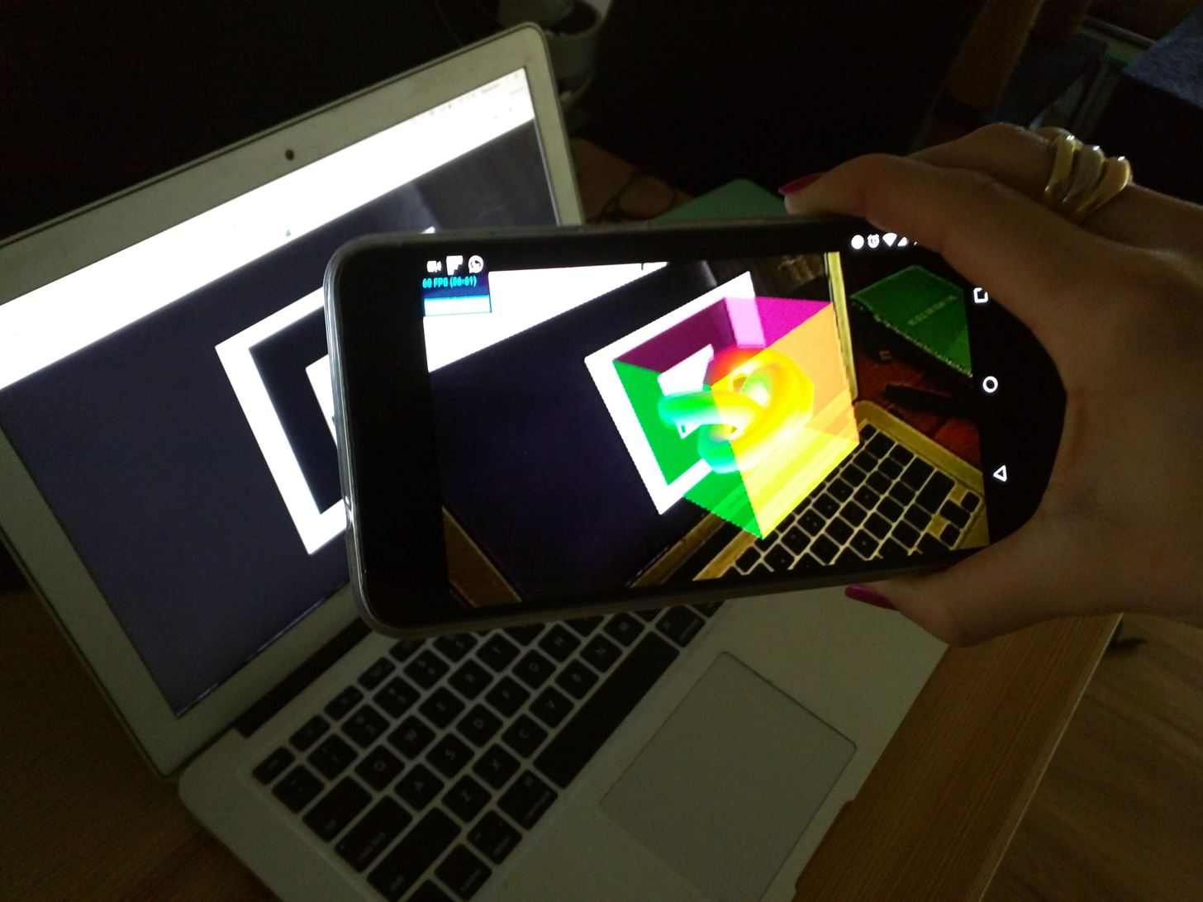
Need of Solution
Student engagement and interest : AR technology spices up the studying with interactive 3D models popping out of textbooks which increases their interest.
Visual Support: Our AR solution provides visual aids to help students understand tough concepts.
Fun Learning Experience: Studying is no longer dull with our AR technology. It's like bringing your textbooks to life, making learning enjoyable and unforgettable.

Slide 6
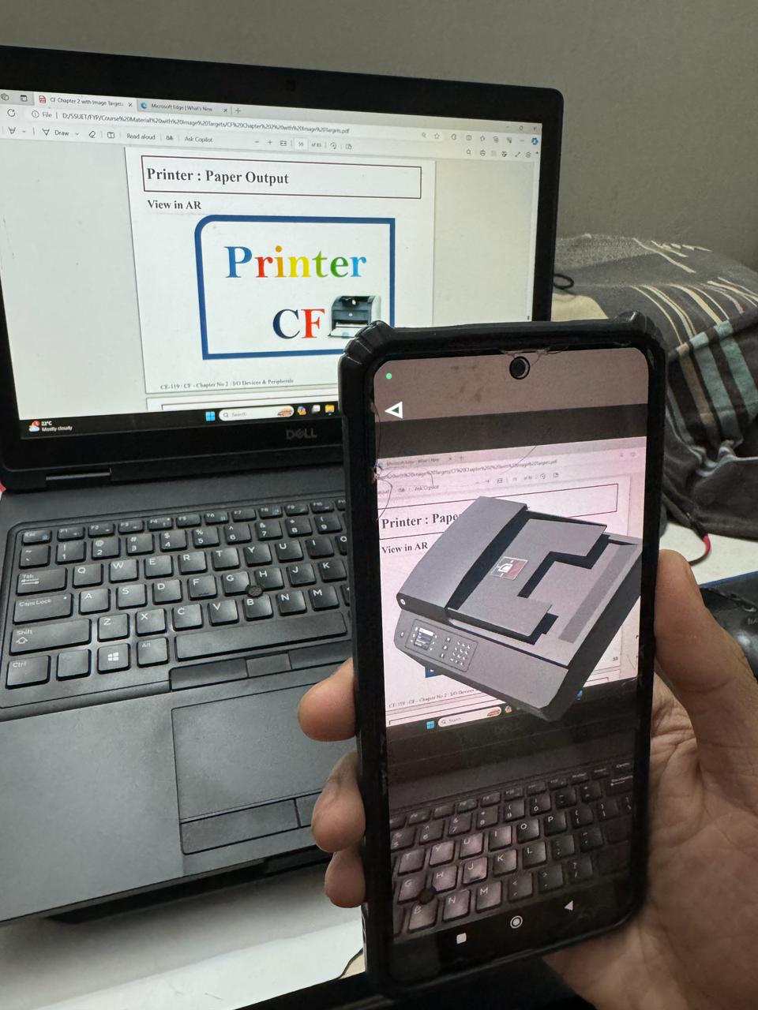
Originality and Creativity
Our aim is to assist students interested in learning about computer hardware and devices.
We offer an interactive and engaging learning experience by utilizing 3D visualizations of computer components and devices through Augmented Reality (AR) technology.
While AR has already found its place in the Medical and Automotive sectors, its adoption in the Education sector is still in its early stages, giving us a competitive edge over other providers.

Slide 7

Project Value Proposition
Interactive Learning Experience​
Provides Interactive learning experience using 3D visualizations of computer components ​
Accessibility & Availability​
24/7 ​ accessibility to learners of all ages​
Future-Readiness​
Align students with future trends and advancements like AR technology​
Cost-Effectiveness​
Reduces the need for physical hardware, making it a more cost-effective learning approach​
Enjoyable Learning​
Enjoyable learning approach increase students' curiosity & motivation​

Slide 8





Software Tools & Programming Language
Blender | Vuforia | Unity | C# | Visual Studio IDE
For designing 3D models and Editing 3D models imported from internet
Provides SDK for AR and stores Image Targets of 3D Models
Integrate image targets, C# scripts and apply textures & animation models
Used for writing scripts of rotation and zoom of 3D models
Used to write C# script

Slide 9
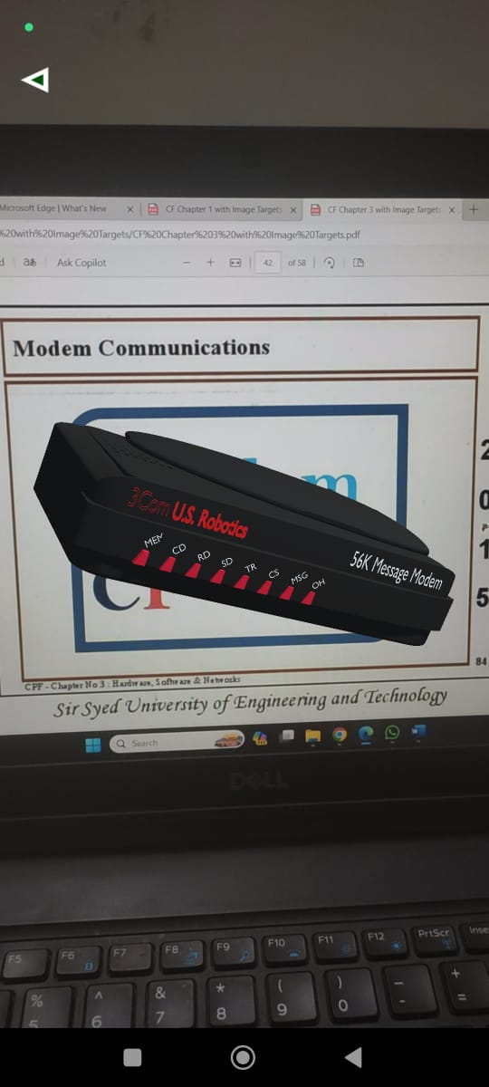
View 3D model on AR Camera
Features
1
Students can view 3D models in AR environment using phone camera

Slide 10
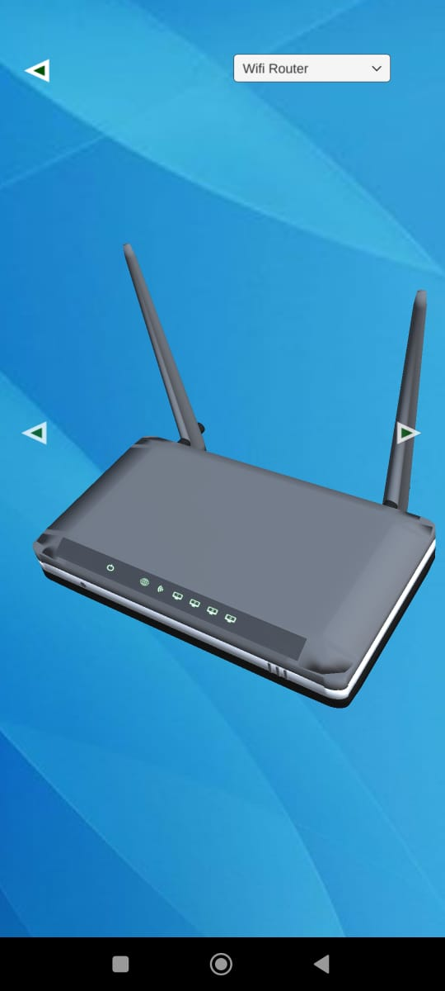
View 3D models manually
Features
2
No image targets, no problem! Students can navigate between the 3D models using navigation

Slide 11

Offline Access
Features
3
No internet, No problem! Once the student download the App no internet is required to run the App

Slide 12
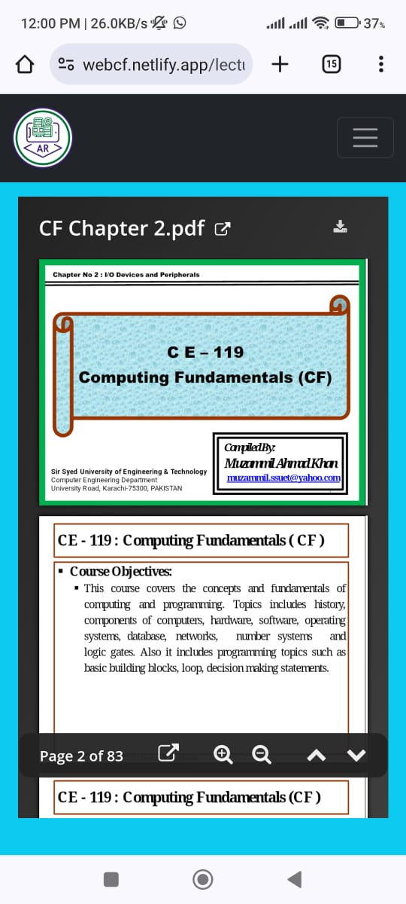
View & Download Lectures
Features
4
Students can view and download lectures using AR-CF website

Slide 13
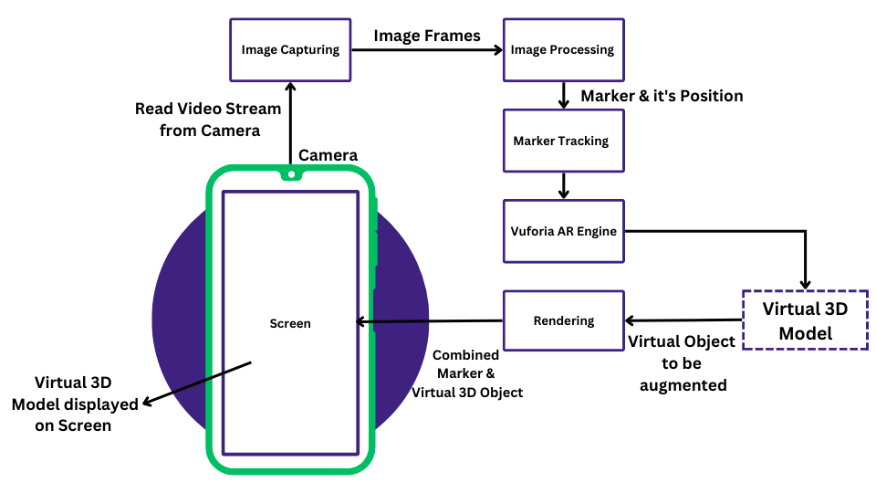
System Functional Diagram

Slide 14
Project Design Progress
Planning Phase
Design Phase
Development
Execution
Monitoring & Testing
Research & Planning
of Project
Implementation​
Designing Of 3D Models​
Implementation of
AR in 3D Models &Interaction of 3D Model
Execution of an AR App on Android
Testing of
Initial prototype

Slide 15
Performance Metrics
Rendering Aspect | Performance Metric
Frame Rate | 30 fps
Model Loading Time | 0.1-0.2 seconds
Touch responsiveness | 0.15-0.2 seconds

Slide 16
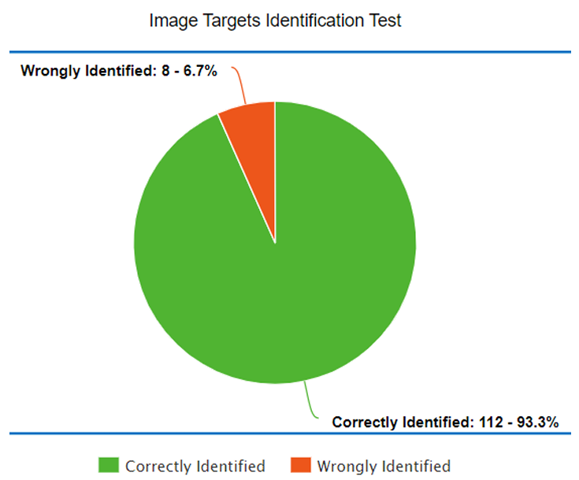
Experiments & Results
We performed image targets identification tests
120 times on different devices
We achieved accuracy of 93.3%

Slide 17
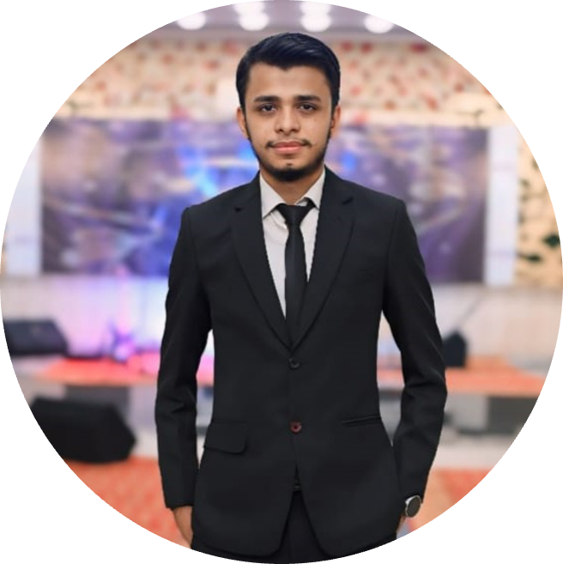


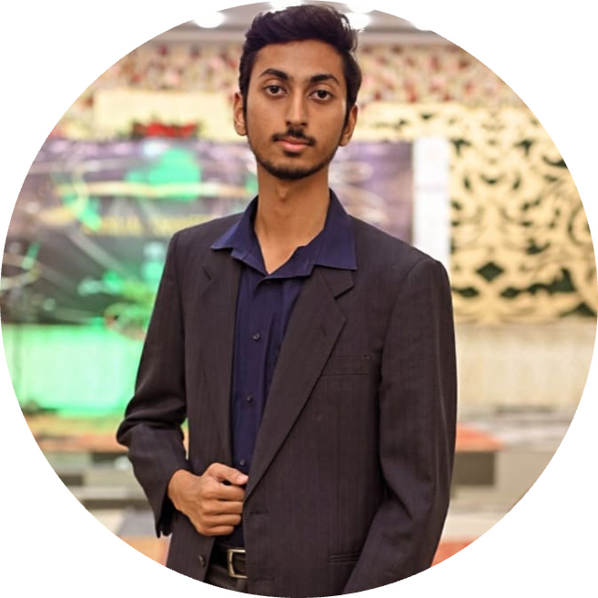
Work Divisioning
Ramish Masood ​
(2020-CE-086)​
Adil Aijaz
(2020-CE-095)​
Qasim
(2020-CE-113)​
Zahir Khan
(2020-CE-121)​
Unity Developer/ UI Designer
3D Models /
Documentation
3D Models /
Documentation
Unity Developer /
Web Developer

Slide 18
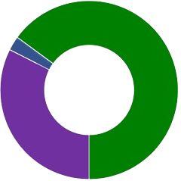
Project Costing
1.2% 3D Models
2$ (570 PKR)
Total Cost = $77 (21507 PKR)
14.1% Google Play Store
25$ (7132 PKR)
28.2% Miscellaneous
50$ (14265 PKR)

Slide 19




Commercial Use
 | Education | AR Learning Platforms | Product Demonstrations
Notes:
Education & Training: Transforming computer science education with AR virtual labs and remote learning.
Corporate Training: Accelerating onboarding and professional development through immersive AR in computer fundamentals.
AR Learning Platforms: Integrating customized AR modules for a comprehensive and specialized educational experience.
Product Demonstrations: Engaging customers with interactive AR presentations for showcasing and selling computer hardware.

Slide 20
Conclusion
Our "AR Based Computer Fundamentals Course App" presents a pioneering solution to the challenges of teaching computer hardware visualization. By leveraging the power of AR, our project offers an innovative and immersive learning experience, enabling students to interact with virtual computer components and overcome the limitations of traditional teaching methods. This fosters practical understanding and enhances the overall learning process.

Slide 21
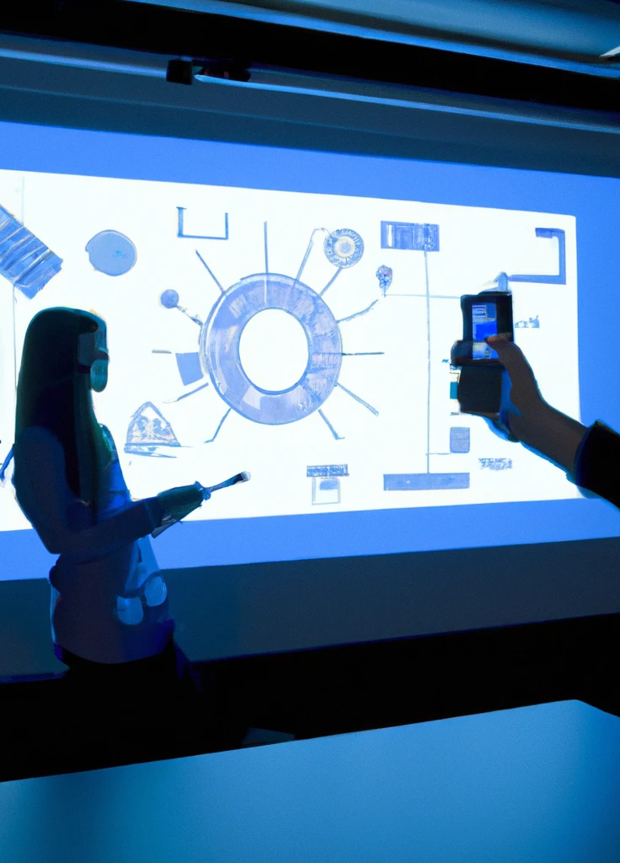
Thank you!

